Slide 1



Spring Cloud: API Gateway – Cloud Gateway Audience: Developer

Slide 2
Introduction
Spring Cloud: API Gateway – Cloud Gateway
Who I am: <Instructor Name>
Title
Organization
Role
Background

Slide 3
Agenda
Spring Cloud: API Gateway – Cloud Gateway
Microservices – History, Driving Forces, and Definition
Microservices Patterns
DevOps
Reactive Microservices
1
5
9
13
AD
All
D
AD
A
Microservices Prerequisites
Integration
Securing Microservices
Testing
2
6
10
14
AD
AD
A
D
A
A
Spring Boot
Migrating Monoliths to Microservices
Domain Driven Design Testing
Scaling Microservices
3
7
11
15
AD
D
A
A
A
Case Study
Cloud
UI
Microservices Anti-Patterns
4
8
12
16
AD
AD
All
All
A
A
Legend: All Developer Advanced Developer Architect
All
D
AD
A

Slide 4

Objectives
Spring Cloud: API Gateway – Cloud Gateway
At the end of this training, you should be able to understand the following:
Need for API Gateway
Gateway Pattern
Spring Cloud Gateway

Slide 5
Topics
Spring Cloud: API Gateway – Cloud Gateway
Gateway
Spring Cloud Gateway

Slide 6
The Current System
Spring Cloud: API Gateway – Cloud Gateway
Existing application:
Runs fine, within a reliable, high-speed, secure network
App Server
Product
Payment
Cart
Catalogue
Order
Rewards

Slide 7
Accessing Microservices via Web
Spring Cloud: API Gateway – Cloud Gateway
Accessing over public internet problematic
Internal API exposed
Security
CORS Required
Multiple Trips and so on
HTML Web Page
Public Internet
Product
Payment
Cart
Catalogue
Order
Eureka Server
Config Server
Rewards
CORS – Cross Origin Resource Sharing

Slide 8
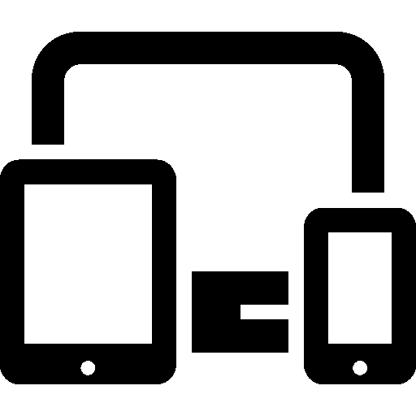
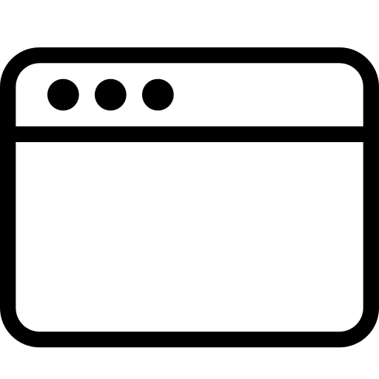

Accessing Microservices via Web (continued)
Spring Cloud: API Gateway – Cloud Gateway
Different clients have different needs!
Public Internet
Noun
Subject
Verb
Adjective
Article
Eureka Server
Config Server

Slide 9
API Gateway
Spring Cloud: API Gateway – Cloud Gateway
API Gateway provides simplified access for client
Custom API
Security
No CORS Required
Fewer Trips and so on
Public Internet
API Gateway
API Gateway
API Gateway
Noun
Subject
Verb
Adjective
Article
Eureka Server
Config Server

Slide 10
API Gateway (continued)
Spring Cloud: API Gateway – Cloud Gateway
Built for specific client needs (“facade”)
Reduces # remote calls
Routes calls to specific servers
Handles Security/SSO
Handles caching
Protocol Translation
Optimizes Calls/Link Expansion
Public Internet
API Gateway
Subject
Noun
Verb
Article
Adjective

Slide 11
Protocol Translation: The Issue
Spring Cloud: API Gateway – Cloud Gateway
Translate between front-end and back-end protocols.
HTTP / REST
HTTP / REST
Public Internet
API Gateway
HTTP / REST
AMQP
Microservice
SOAP
Microservice
JMS
Microservice
Microservice
Microservice

Slide 12
Protocol Translation: The Issue (continued)
Spring Cloud: API Gateway – Cloud Gateway
Adapters can be used.
HTTP / REST
HTTP / REST
Public Internet
API Gateway
HTTP / REST
AMQP
Messaging
Adapter
Microservice
SOAP
JMS
Microservice
Microservice
Messaging
Adapter
Microservice
Microservice

Slide 13
Protocol Translation: The Options
Spring Cloud: API Gateway – Cloud Gateway
No Quick Fixes!
JMS – Use JMS Template
AMQP – Use AMQP Template
SOAP – Use WebServiceTemplate

Slide 14
Protocol Translation: Spring Integration
Spring Cloud: API Gateway – Cloud Gateway
Spring Integration
Powerful framework for enterprise integration patterns and in-memory messaging.
http://projects.spring.io/spring-integration/
Adapters and Gateways for:
AMQP, ATOM, Flat Files, FTP(S), Gemfire, HTTP, JDBC, JMS, JMX, JPA, eMail, Mongo, MQTT, Redis, RMI, SFTP, streams, syslog, TCP, Twitter, UDP, Web Services (SOAP), Web Sockets, XMPP

Slide 15
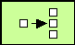

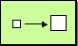

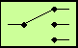

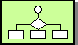
Spring Integration
Spring Cloud: API Gateway – Cloud Gateway
API Gateway
Spring Integration
SOAP
SMTP
AMQP
JMS
ATOM
TCP
Notes:
Spring Integration is notoriously difficult to explain, and ultimately since it is out of scope for this course I'm going to need to refer you to other resources, but to put it briefly:
Spring Integration allows us to build an in-memory messaging system within any Spring appliction, including our API gateway. Within our messaging system we can assemble pre-build enterprise integration components that perform specific pre-defined functions.
An example of a message might be when the client of our gateway sends us a GET REST request asking for information on a product or a team or anything our application deals with. We would use a SI component called a Gateway to receive the request, and send it through message channels to an outbound gateway for JMS or AMQP or some asynchronous technology. SI hooks into the back-end technology and handles associating the returned message with the original request, which we would send via message channels back to the original gateway.
The advantage of using SI, other than the fact that we don't have to write code for the various technologies we integrate with, is that we start to think in terms of messages and payloads, and when we are writing an API gateway this is what we really need to think about. Recieving messages, sending out messages, combing returned messages and so on.

Slide 16
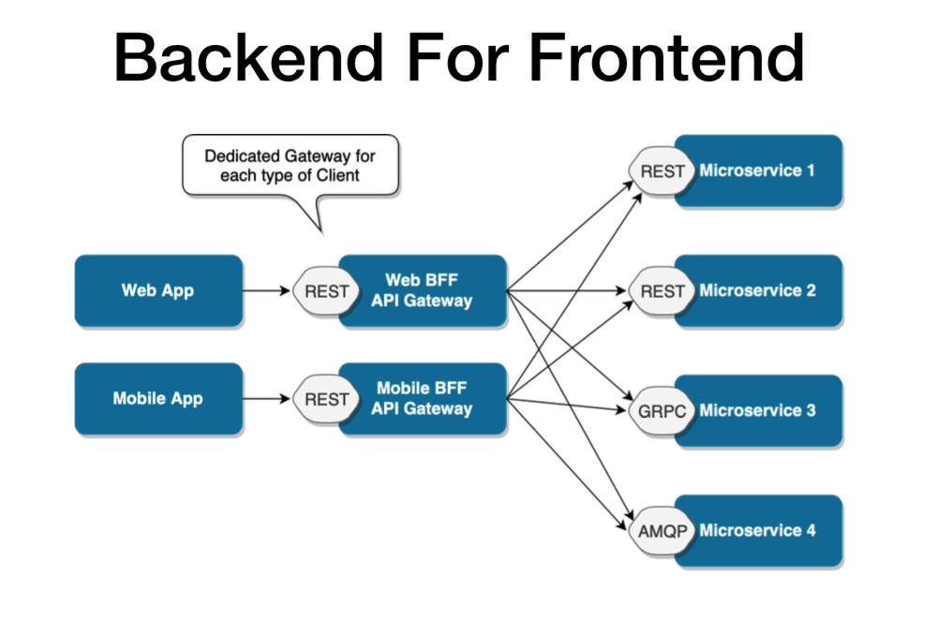
Backend for Frontend (BFF)
Spring Cloud: API Gateway – Cloud Gateway
One backend per user experience
BFF tightly coupled to a specific user experience and will typically be maintained by the same team as the user interface
API Gateway used to make the BFF
https://samnewman.io/patterns/architectural/bff/ https://tsh.io/blog/design-patterns-in-microservices-api-gateway-bff-and-more/
Notes:
So the API Gateway is build to address the remote client's needs. It's a one-stop-shop for the client to access.
Serves as a “Facade” to the real API, and just to be clear it lives on server side, not client.
Reduces # of calls, it can reduce the data carried in calls.
In simple cases, it simply routes to the real back end services, and that's what I'll show you first with Zuul.
It handles Caching: reducing # of service calls
It can handle protocol translation. What this means is that the back-end microservices might be setup to work with messaging protocols instead of HTTP. Well the API gateway would take care of taking the client's HTTP request, putting it into a message, potentially waiting for a reply message, and returning a response. The client application has no need to deal with any messaging.
The API gateway can also optimize calls to the back-end API by expanding hyperlinks found within RESTful resources. Many times if we are following RESTful principles correctly our microservices send links to related resources, and it is up to the client to make the decision whether to follow the links or not. Well the API gateway can take care of resolving these calls and “inlining” the response so the client gets just the data it needs with no waste or extra round-trips.

Slide 17
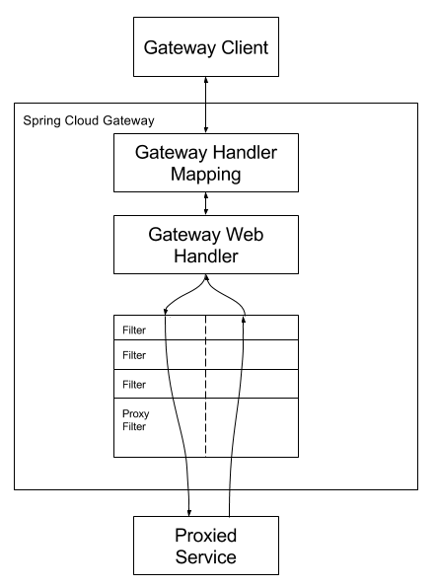
Spring Cloud Gateway
Spring Cloud: API Gateway – Cloud Gateway
Provides an API Gateway built on top of the Spring Ecosystem, including: Spring 5, Spring Boot 2 and Project Reactor
Aims to provide a simple, yet effective way to route to APIs and provide cross cutting concerns to them such as: security, monitoring/metrics, and resiliency
Based on:
Route: The is a basic building block of the gateway. It is defined by an ID, a destination URI, a collection of predicates, and a collection of filters. A route is matched if the aggregate predicate is true.
Predicate: This is a Java 8 Function Predicate. The input type is a Spring Framework ServerWebExchange. This lets you match on anything from the HTTP request, such as headers or parameters.
Filter: These are instances of Spring Framework GatewayFilter that have been constructed with a specific factory. Here, you can modify requests and responses before or after sending the downstream request.
Notes:
So the API Gateway is build to address the remote client's needs. It's a one-stop-shop for the client to access.
Serves as a “Facade” to the real API, and just to be clear it lives on server side, not client.
Reduces # of calls, it can reduce the data carried in calls.
In simple cases, it simply routes to the real back end services, and that's what I'll show you first with Zuul.
It handles Caching: reducing # of service calls
It can handle protocol translation. What this means is that the back-end microservices might be setup to work with messaging protocols instead of HTTP. Well the API gateway would take care of taking the client's HTTP request, putting it into a message, potentially waiting for a reply message, and returning a response. The client application has no need to deal with any messaging.
The API gateway can also optimize calls to the back-end API by expanding hyperlinks found within RESTful resources. Many times if we are following RESTful principles correctly our microservices send links to related resources, and it is up to the client to make the decision whether to follow the links or not. Well the API gateway can take care of resolving these calls and “inlining” the response so the client gets just the data it needs with no waste or extra round-trips.

Slide 18
Lab
Create Spring Cloud Gateway and access the client facing service using gateway.
Use Eureka for service lookup from Spring Cloud Gateway
Running the newly created project
Notes:
Here you can just run the project. Emphasize that it is just a Java “main” application.
It will simply load the Spring application context, then exit when it is apparent there is nothing else to do.
We will add to this later.

Slide 19

Q&A

Slide 20

Summary
Spring Cloud: API Gateway – Cloud Gateway
Summary
In this course, you learned about the following:
API Gateway pattern
BFF
Spring Cloud Gateway

